Slide 1
Distributed Denial-of-Service Attacks
CS6500: Network Security
Reading Assignment Presentation
by Sanjana Prabhu

Slide 2
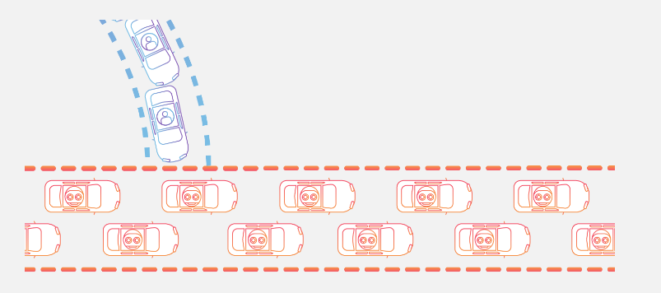
What is a DDoS attack?
Notes:
DDoS attack or distributed Denial-of-service attack is a type of network security attack wherein the attacker tries to disrupt traffic of a user by flooding the network with a lot of unwanted traffic. This huge amount of unwanted traffic creates a load on the network core, and the user is unable to access the network services and resources as desired. Therefore, the ”Availability” aspect of security is compromised. From a high level, a DDoS attack is like an unexpected traffic jam, preventing regular traffic from arriving at its destination.

Slide 3
History and some notable DDoS attacks
2000: DDoS attack on CNN, Yahoo etc. by 15 year old boy
2016: Dyn DDoS attack
2018: DDoS attack on GitHub
Used as diversional attacks
Notes:
In 2000, Michael Calce, a 15-year-old boy who used the online name “Mafiaboy,” launched one of the first recorded DDoS attacks. Calce hacked into the computer networks of a number of universities. He used their servers to operate a DDoS attack that crashed several major websites, including CNN, E-Trade, eBay, and Yahoo. Calce was convicted of his crimes in the Montreal Youth Court. As an adult, he became a “white-hat hacker” identifying vulnerabilities in the computer systems of major companies.
More recently, in 2016, Dyn, a major domain name system provider — or DNS — was hit with a massive DDoS attack that took down major websites and services, including AirBnB, CNN, Netflix, PayPal, Spotify, Visa, Amazon, The New York Times, Reddit, and GitHub.
The gaming industry has also been a target of DDoS attacks, along with software and media companies.
DDoS attacks are sometimes done to divert the attention of the target organization. While the target organization focuses on the DDoS attack, the cybercriminal may pursue a primary motivation such as installing malicious software or stealing data.

Slide 4
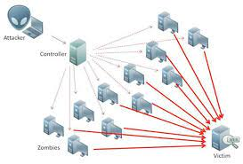
How are DDoS attacks carried out?
Attacker takes control of several compromised devices
Each send requests to the target
Ultimately flooding it with traffic
Notes:
DDoS attacks are carried out with networks of Internet-connected machines.These networks consist of computers and other devices (such as IoT devices)which have been infected with malware, allowing them to be controlled remotely by an attacker. These individual devices are referred to as bots (or zombies), and a group of bots is called a botnet. Once a botnet has been established, the attacker is able to direct an attack by sending remote instructions to each bot.
When a victim’s server or network is targeted by the botnet, each bot sends requests to the target’s IP address, potentially causing the server or network to become overwhelmed, resulting in a denial-of-service to normal traffic. The traffic can consist of incoming messages, requests for connections, or fake packets Because each bot is a legitimate Internet device, separating the attack traffic from normal traffic can be difficult.

Slide 5
Symptoms of a DDoS attack
Suspiciously large amounts of traffic originating from a single IP address or IP range
Lots of traffic originating from devices having similar features(such as device type, geographic location etc.)
Odd traffic patterns
Excessive spam mails

Slide 6
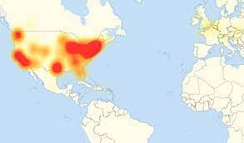
In recent times...
IoT devices are being used as bots
Security of IoT devices is not as advanced as that of laptops, PCs
Dyn DDoS attack :
Orchestrated using IoT devices(100,000+)
Affected by Mirai malware
Services like Amazon, Netflix affected
1.2 Tb/s traffic
Notes:
Increasingly, the millions of devices that constitute the ever-expanding Internet of Things (IoT) are being hacked and used to become part of the botnets used to deliver DDoS attacks. The security of devices that make up the Internet of Things is generally not as advanced as the security software found in computers and laptops. That can leave the devices vulnerable for cybercriminals to exploit in creating more expansive botnets.
The 2016 Dyn attack was accomplished through Mirai malware, which created a botnet of IoT devices, including cameras, smart televisions, printers and baby monitors. The Mirai botnet of Internet of Things devices may be even more dangerous than it first appeared. That’s because Mirai was the first open-source code botnet. That means the code used to create the botnet is available to cybercriminals who can mutate it and evolve it for use in future DDoS attacks.
The Mirai botnet was significant in that, unlike most DDoS attacks, it leveraged vulnerable IoT devices rather PCs and servers, It’s especially scary when one considers that by 2020, according to BI Intelligence, there will be 34 billion internet connected devices, and the majority (24 billion) will be IoT devices.

Slide 7
Types of DDoS attacks
Volume based attacks
Protocol/Network layer attacks
Application layer attacks
Notes:
There are three primary classes of DDoS attacks:
Volume-based attacks use massive amounts of bogus traffic to overwhelm a resource such as a website or server. They include ICMP, UDP and spoofed-packet flood attacks. The size of a volume-based attack is measured in bits per second (bps).
Protocol or network-layer DDoS attacks send large numbers of packets to targeted network infrastructures and infrastructure management tools. These protocol attacks include SYN floods and Smurf DDoS, among others, and their size is measured in packets per second (PPS).
Application-layer attacks are conducted by flooding applications with maliciously crafted requests. The size of application-layer attacks is measured in requests per second (RPS).

Slide 8
Some examples
TCP layer/Syn floods: exploits a vulnerability in TCP connection sequence called 3-way handshake
Zero day DDoS attacks: exploits vulnerabilities for which patches have not been released yet
Notes:
TCP Connection Attacks or SYN Floods exploit a vulnerability in the TCP connection sequence commonly referred to as the three-way handshake connection with the host and the server.
Here’s how. The targeted server receives a request to begin the handshake. In a SYN Flood, the handshake is never completed. That leaves the connected port as occupied and unavailable to process further requests. Meanwhile, the cybercriminal continues to send more and more requests overwhelming all open ports and shutting down the server.

Slide 9
Mitigation techniques
Firewalls and routers
Rate limiting
Web application firewall
Anycast network diffusion
Artificial intelligence
Securing IoT devices
Notes:
Firewalls and routers should be configured to reject bogus traffic and you should keep your routers and firewalls updated with the latest security patches. These remain your initial line of defense. Application front end hardware which is integrated into the network before traffic reaches a server analyzes and screens data packets classifying the data as priority, regular or dangerous as they enter a system and can be used to block threatening data.
Limiting the number of requests a server will accept over a certain time window is also a way of mitigating denial-of-service attacks.
A Web Application Firewall (WAF) is a tool that can assist in mitigating a layer 7 DDoS attack. By putting a WAF between the Internet and an origin server, the WAF may act as a reverse proxy, protecting the targeted server from certain types of malicious traffic.By filtering requests based on a series of rules used to identify DDoS tools, layer 7 attacks can be impeded. One key value of an effective WAF is the ability to quickly implement custom rules in response to an attack.
This mitigation approach uses an Anycast network to scatter the attack traffic across a network of distributed servers to the point where the traffic is absorbed by the network. Like channeling a rushing river down separate smaller channels, this approach spreads the impact of the distributed attack traffic to the point where it becomes manageable, diffusing any disruptive capability.
While present defenses of advanced firewalls and intrusion detection systems are common, AI is being used to develop new systems.The systems that can quickly route Internet traffic to the cloud, where it’s analyzed, and malicious web traffic can be blocked before it reaches a company’s computers. Such AI programs could identify and defend against known DDoS indicative patterns. Plus, the self-learning capabilities of AI would help predict and identify future DDoS patterns.
This one is for consumers. To keep your devices from becoming a part of a botnet, it’s smart to make sure your computers have trusted security software. It’s important to keep it updated with the latest security patches.

Slide 10
References
https://www.cloudflare.com/learning/ddos/what-is-a-ddos-attack/
http://us.norton.com/internetsecurity-emerging-threats-what-is-a-ddos-attack-30sectech-by-norton.html
https://www.csoonline.com/article/3222095/ddos-explained-how-denial-of-service-attacks-are-evolving.html
https://www.imperva.com/learn/ddos/ddos-attacks/
Wikipedia

Slide 11
Thank you!

